Slide 1
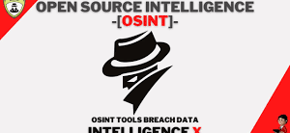
What is Intelligence X…​
By mohamed_4, solnasaleem, Carabinier-crbrown.

Slide 2

Intelligence X Overview
Intelligence X is an independent European technology company founded in 2018 by Peter Kleissner, based in Prague, Czech Republic.
Its mission is to develop and maintain the search engine and data archive.
At the end of the day Intelligence X is an advanced search engine.

Slide 3





The search engine works with selectors, i.e. specific search terms such as…
It searches in places such as the darknet, document sharing platforms, whois data, public data leaks and others.
Intelligence X has a much wider scope of information sources in comparison to normal search engines.

Slide 4
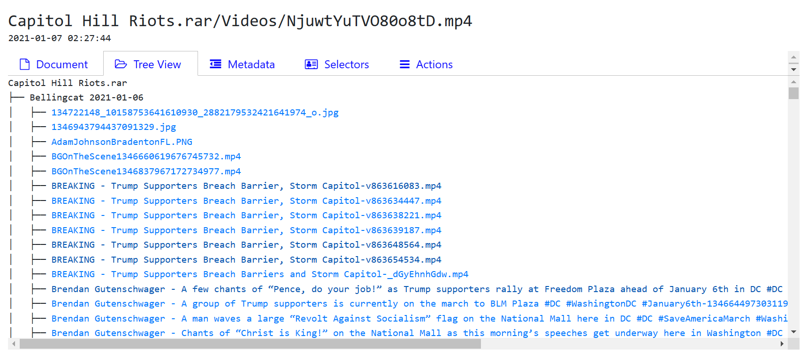
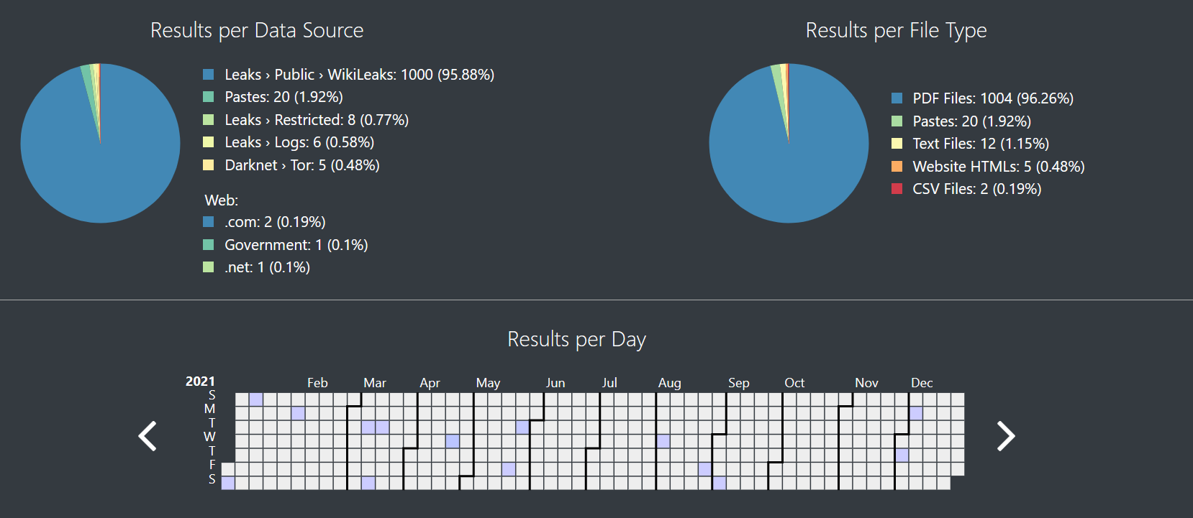
What is revealed?
Different file types such as PDF, text, CSV etc.
Different sources such as Darknet, public leaks, domains etc.
Also gives results per day – tells you when each source of information was uploaded/released.
Drill down into documents with Tree View, Metadata and Selectors.

Slide 5
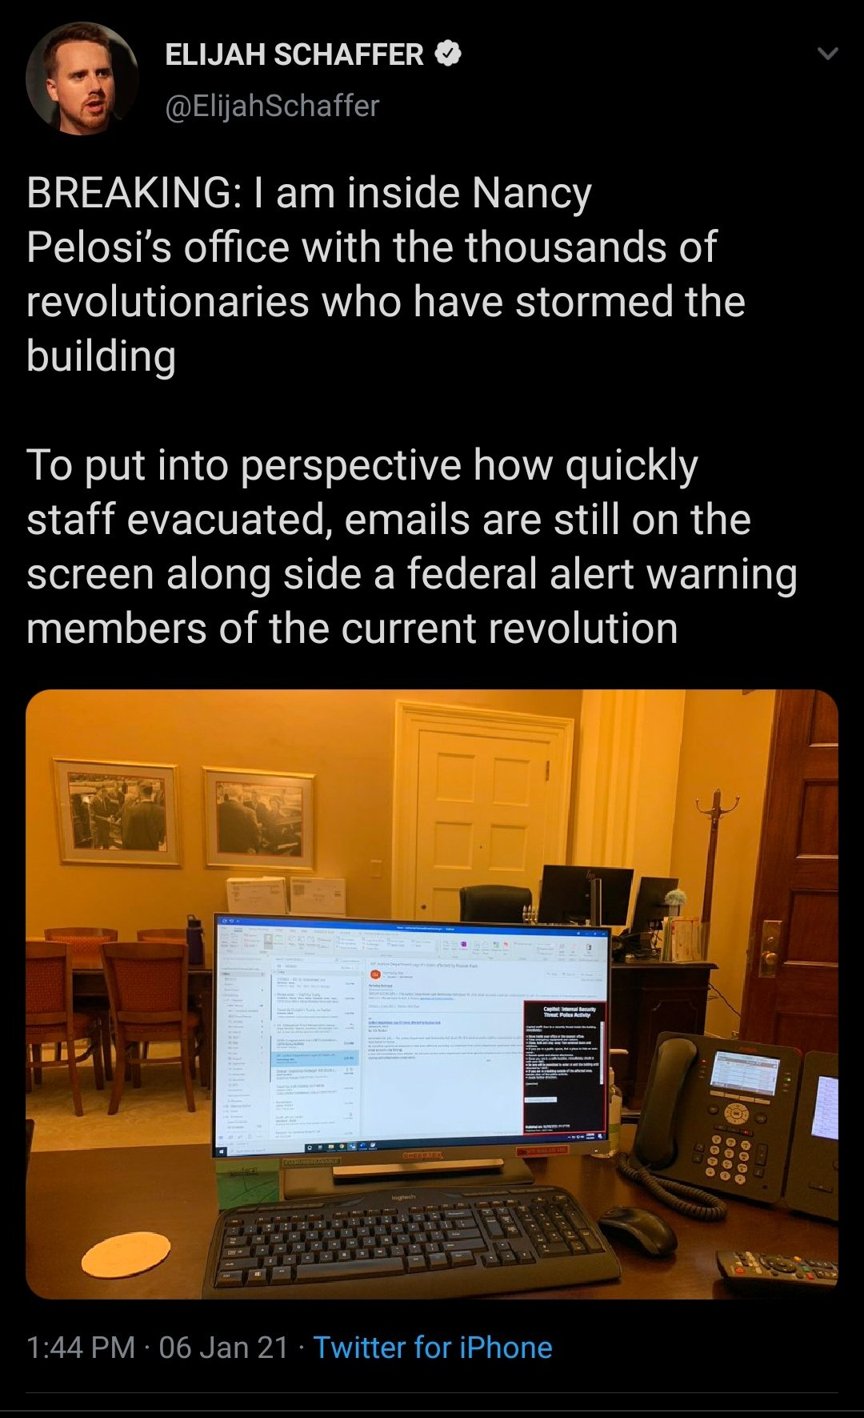
Intelligence X keeps a historical data archive of results, similar to how the Wayback Machine from archive.org stores historical copies of websites.
This is important as:
Provides evidence for law enforcement & the public.
Allows OSINT on peoples’ location and past activities.
Short video of capital hill riots
Intelligence X (intelx.io)

Slide 6
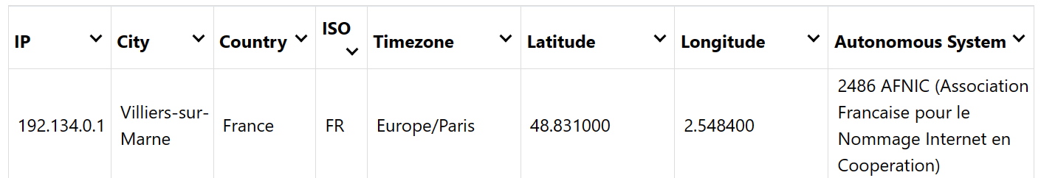
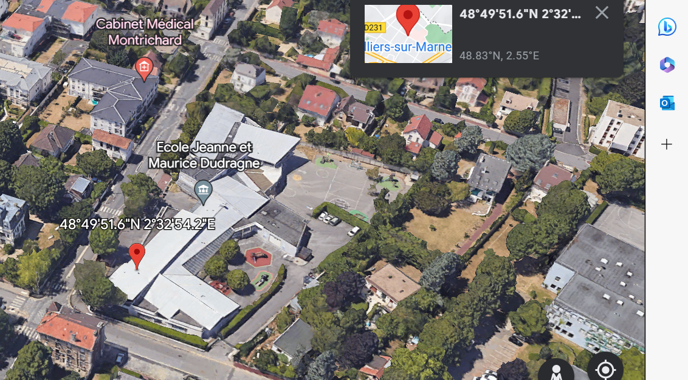
Key Features
for Cyber Security
The key features of Intelligence X that make it useful for cyber security & OSINT, such as:
More advanced search parameters such as Darknet search capabilities.
Social media analysis – e.g. analyse of twitter accounts and location of tweets using Long. & Lat.
Email validation and GeoIP Lookup.
Extract data, text and images from supported files.

Slide 7
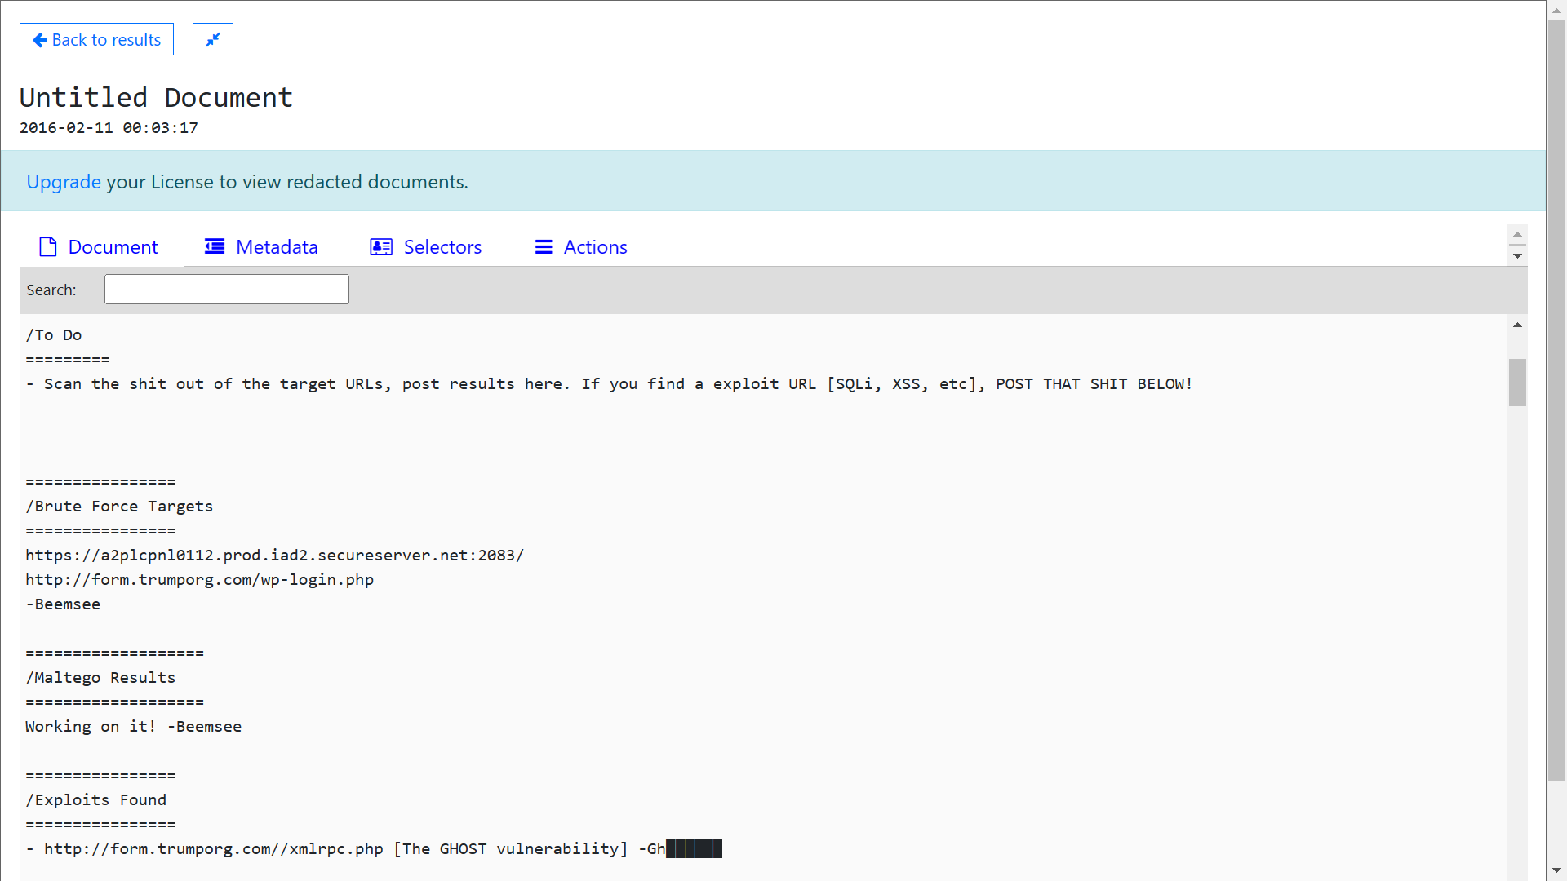
How Intelligence X can be used in cyber security
Searching for indicators of compromise (IOCs)
Identifying threat actors and their motivations.
Analysing tactics, techniques, and procedures (TTPs).
E.G. From the picture we can see an opportunity attack using brute force.
Obtain by researching the Trump Organization's email server.

Slide 8
To Summarize…
Huge scope of hard to find information made easy by specific selector and data source search capabilities.
Combining this with tools such as archiving, social media analysis and GeoIP location lookup, Intelligence X enables effective OSINT.
Thank you for Listening!

